Slide 1
9/19/24
Welcome

Slide 2
Fibi Classes on MyLearning
Fibi Virtual Class: Creating a Proposal and a Service Request
Advanced Fibi for Department Users (Virtual)
For beginners with no background
Understand major components of a proposal.
Learn the essentials of proposal preparation.
Learn the essentials of Service Request preparation.
For department users with proposal experience
Widgets
More Actions icon in a Proposal.
Troubleshoot common problems and errors.
Service Request preparation.
Reports

Slide 3
Upgrade
Tentative plans
Polus will roll out Version 5.0 for testing in October
ORIS –> test for a week
Further testing –> another week
Fixes -> Polus
Cutover to QA – test for a week
Cutover to TR – test for a week
Possibly ready for PR in mid
to late November
Changes include:
Pop-up windows
New SR functionality
Copy
Deactivate
Delete drafts
Recall
Attachment tab
Widget
Search – created date

Slide 4
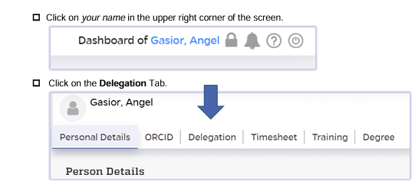
Delegation of Approval – Department Business Offices

Slide 5
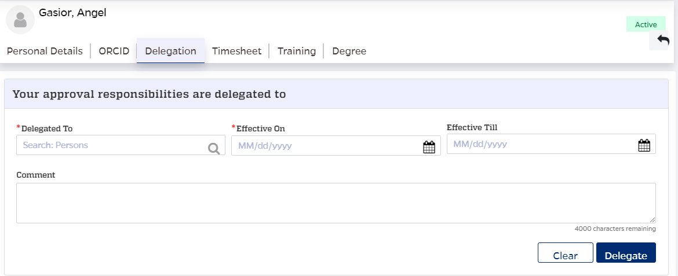

Slide 6
FAQ – Not all of the tabs are showing…

Slide 7
Next Bits is on
Thursday, October 3rd
Register at oris.jhu.edu

