Slide 1
8/1/24
Welcome

Slide 2
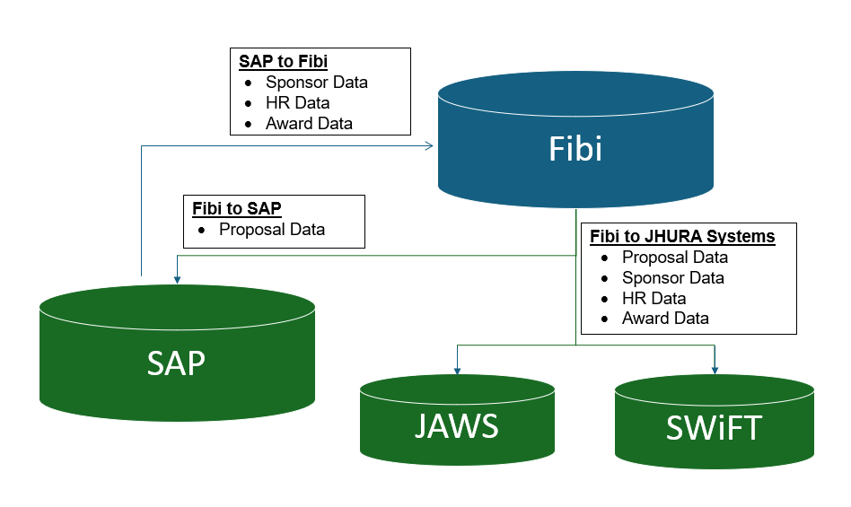
System Feeds
Contact ORIS if:
IPN is not showing in JAWS, SWIFT, or SAP
____________________
If JHU Key Personnel are not in Fibi, contact your HR rep to create a mini master.
If a Sponsor is not in Fibi, create a Service Request for a New Sponsor. SPSS will process.

Slide 3
Next Bits is on
Thursday, August 15th
Register at oris.jhu.edu

