Slide 1
8/15/24
Welcome

Slide 2
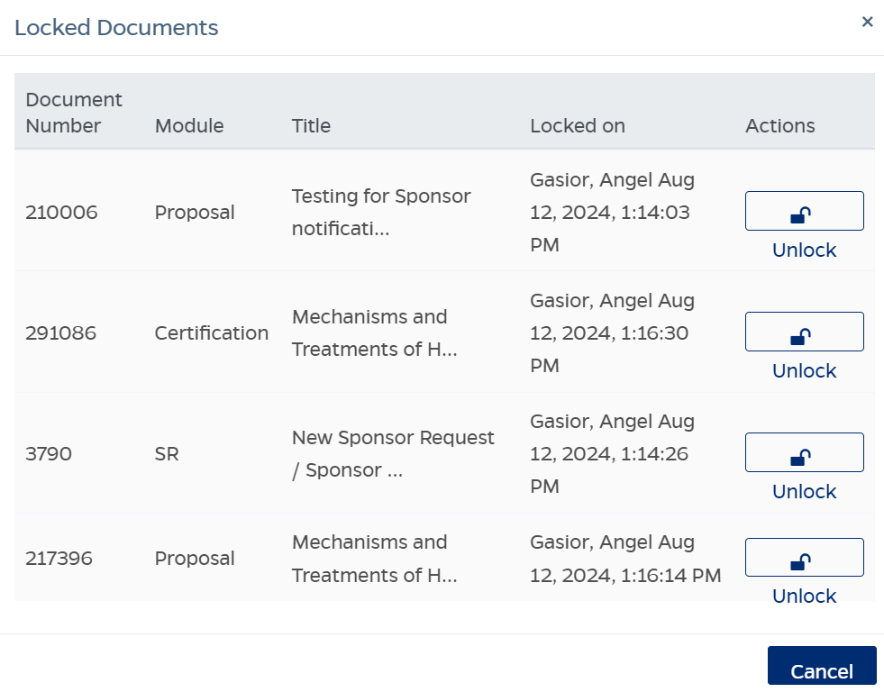
Unlock
PD, SR, Certification
Go to the lock icon next to your name and click on unlock under the actions column.
Avoid locking issues by going to the Dashboard
For more information, go to oris.jhu.edu > Guides > Unlock a PD

Slide 3
Service Requests
Subject Lines
Why does the submit button not show?
Enhancements and Updates
Recall, Deactivate, and add a Personnel tab for certifications

Slide 4
Update
IP Summary - includes the Proposal Preparer Contact
Business scenario – The user does not have access to all cost centers/lead units, but all users can access all IP records. This information now gives the user a contact they can reach for more information if needed.
STEPS:
1. Go to IP record.
2. Print the IP Summary or review the Other tab for the contact.

Slide 5
This Weekend - Service Request Update
1. Service Requests will have a slight change to their questionnaires.
This will affect:
Unfunded Collaboration (SOM only)
Material Transfer Agreement (SOM only)
Modification of an Unfunded Contract (SOM only)
2. Pre-award Requests will have a new question added.
Service Requests that were begun this week, but not completed, may need to have the updated questionnaires answered.

Slide 6
Next Bits is on
Thursday, September 19th
Register at oris.jhu.edu

